Slide 1


SOCIAL DISTANCING DETECTION
ANN PROJECT

Slide 2
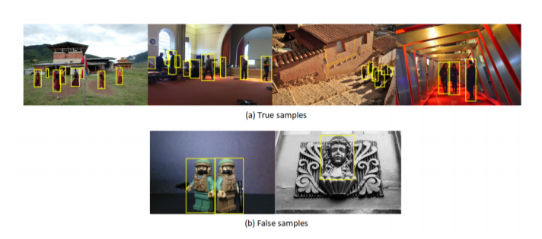

Slide 3
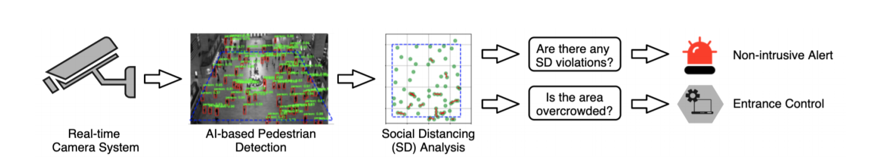
Real-Time SCENARIO

Slide 4
STEPS TO WORK
1. Detecting distances between humans from monocular images (Inputs from user).
2. Should generate a set of bounding boxes and an ID for each identified person.
3. Each individual is associated with three-dimensional feature space (x, y, d).

Slide 5
STEPS TO WORK
4. Forming Group
5. vi = np/ng, where vi is the violation index.

Slide 6
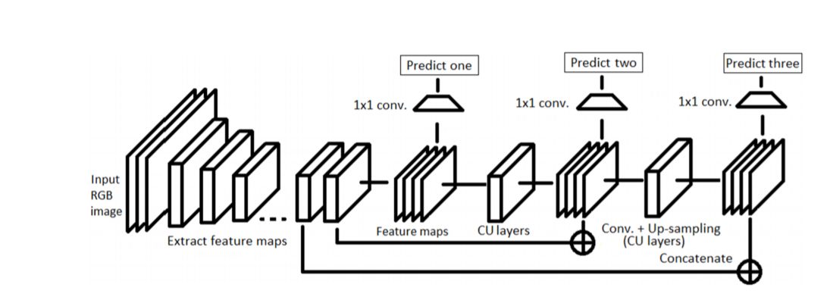
Schematic representation of YOLO v3 architecture

Slide 7
WORK CONTRIBUTION
Detecting Humans without errors
Detecting distances
Gopi Chandhan Sri Priya

Slide 8
THANK YOU
Valluru SRI PRIYA
GSIMHADRI GOPI CHANDHAN

